Slide 1
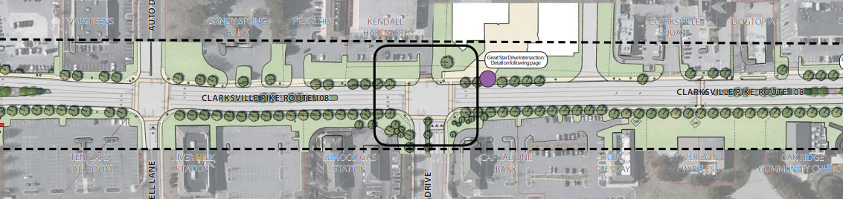
Clarksville Pike Popeyes
Presented to: Howard County Design Advisory Panel
8 March 2023

Slide 2
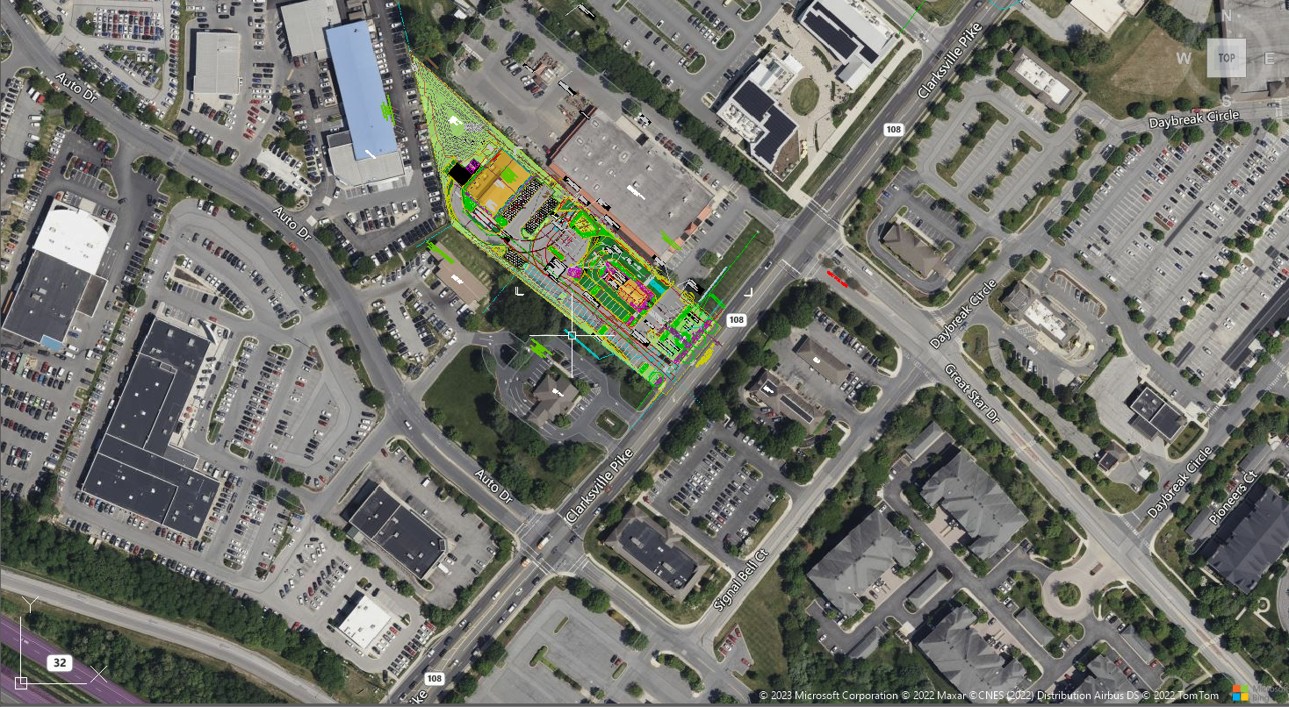
Site Context

Slide 3
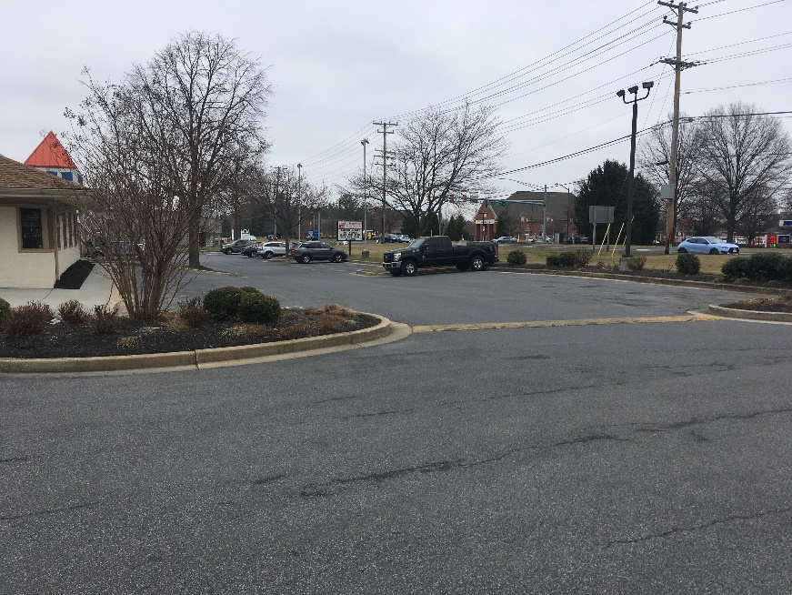
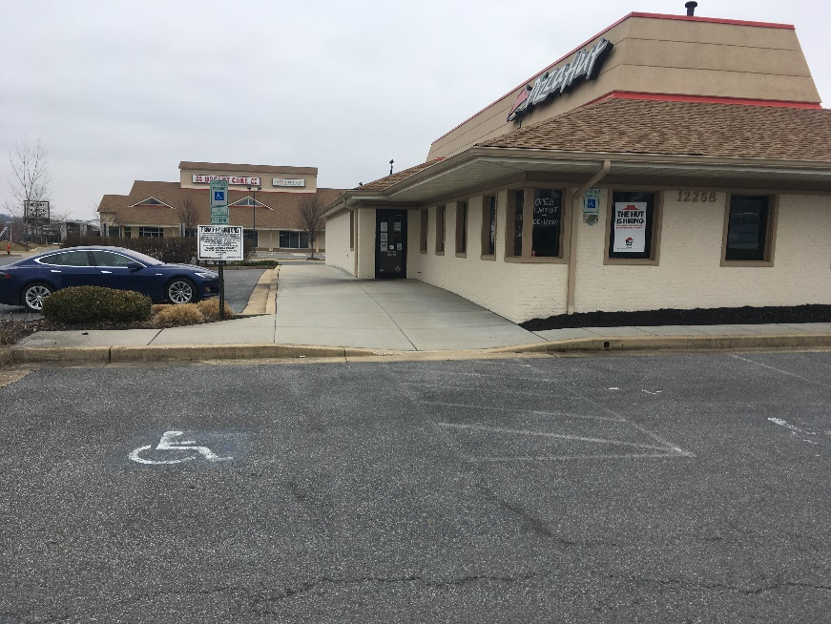
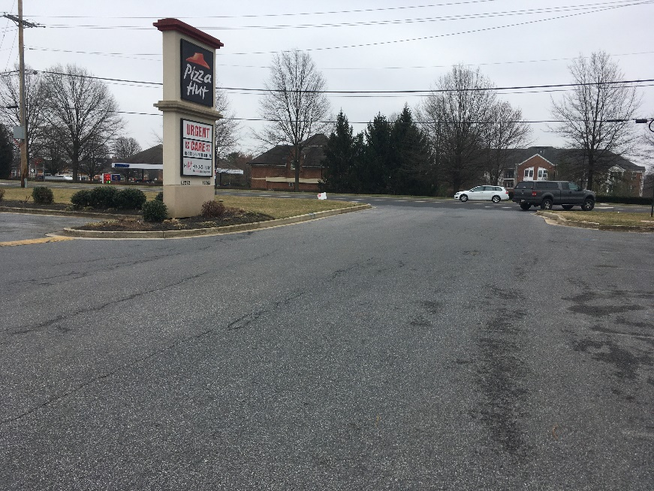
Existing Conditions Photos
Through Access to Kendall Hardware
Existing Pizza Hut and Urgent Care
Entrance and Existing Sign

Slide 4
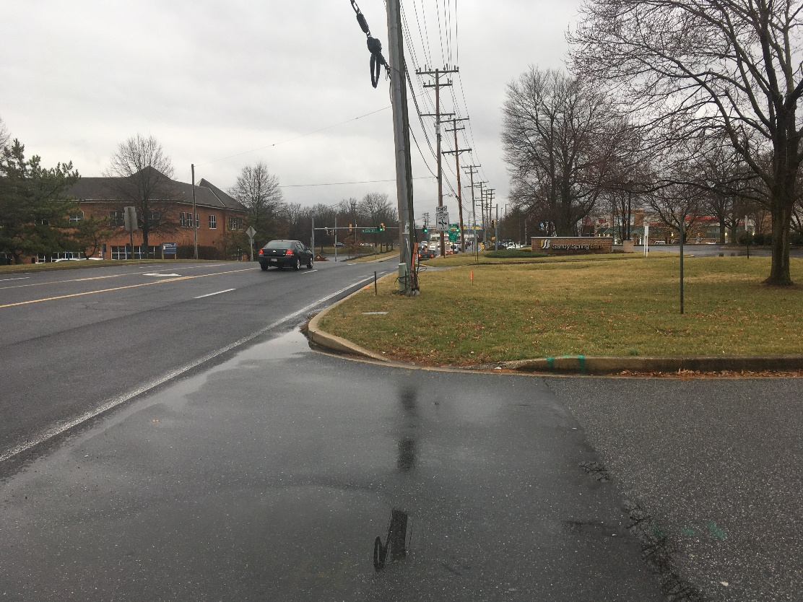
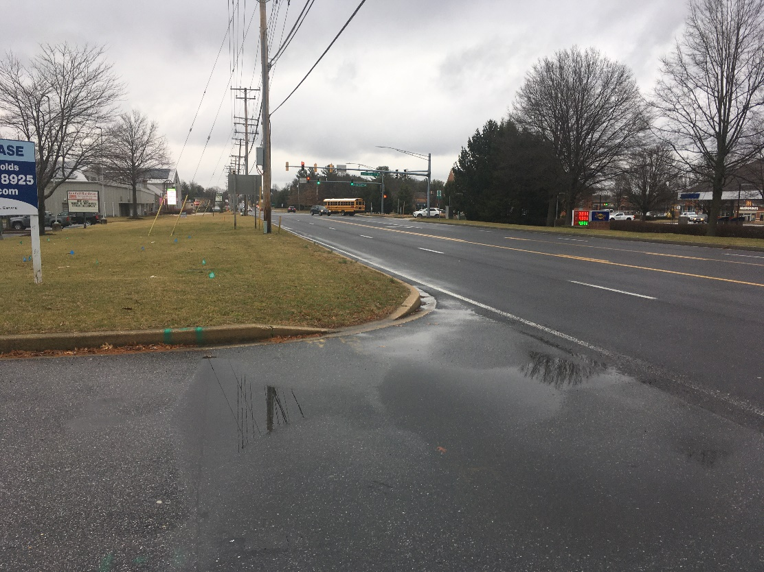
Site Access
Looking Southwest
Looking Northeast

Slide 5
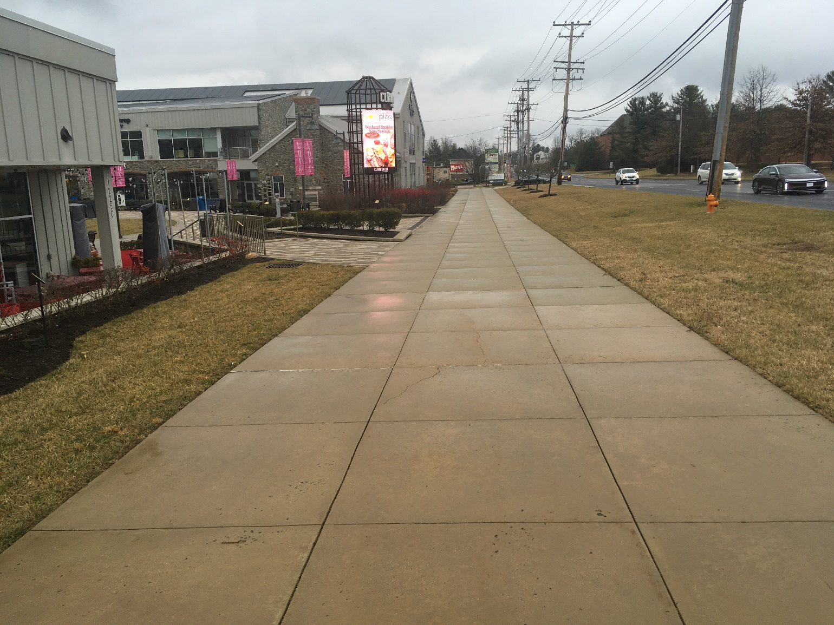
PROPOSED WALKWAY FINISH

Slide 6
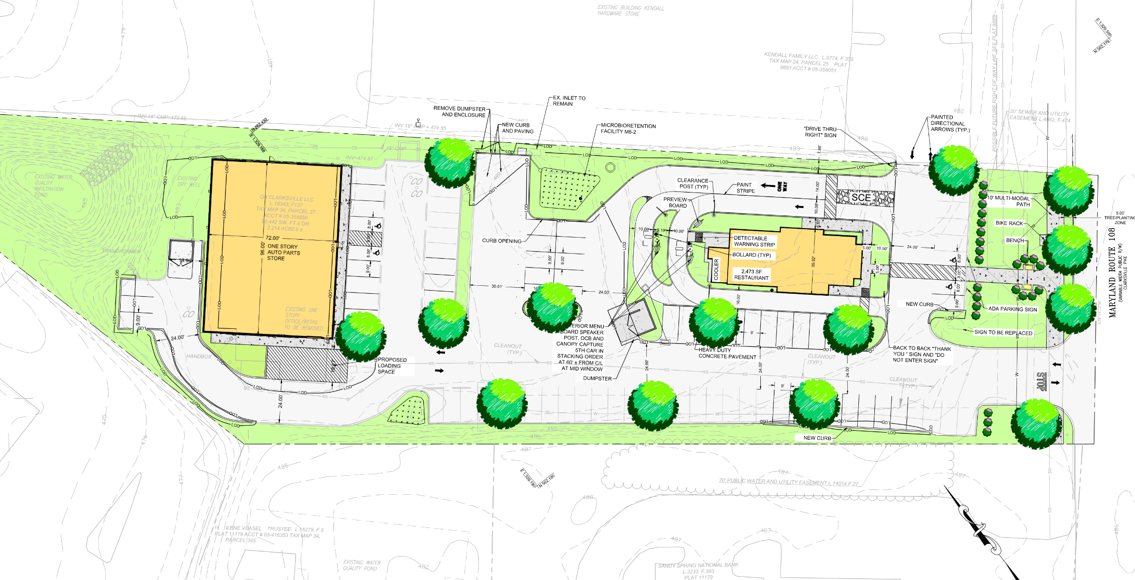
Proposed Site Plan

Slide 7
Section Two Corridor Plan
10’-wide Shared Use Path
Bike Racks in Pedestrian/Shared Use Zone
Benches in Building Frontage Zone
Street Trees (small to accommodate overhead lines)
Native Species
100% Parking Lot Screening

Slide 8

Relationship to 108 Corridor

Slide 9
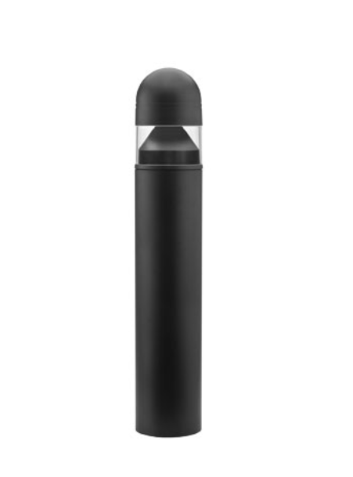
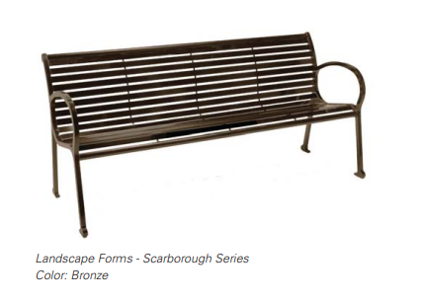
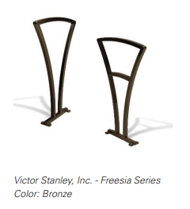
Street Furnishings
Lithonia Dome Top Round LED Bollard

Slide 10
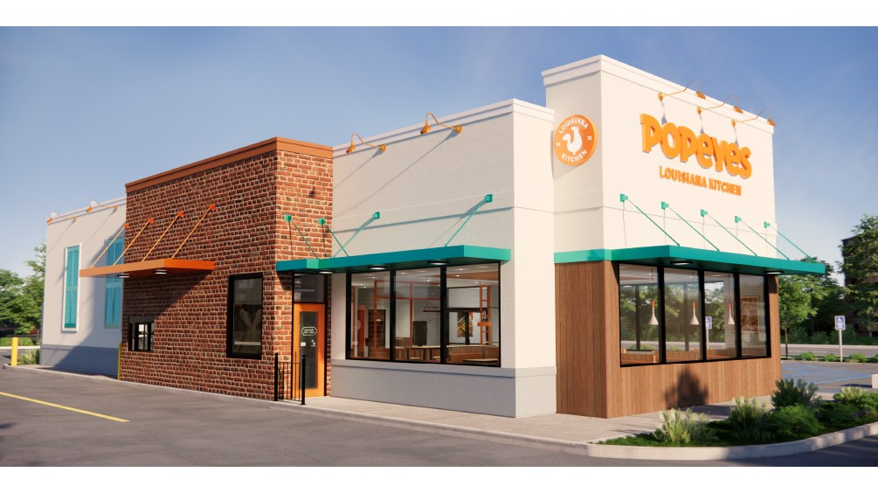
Architecture

Slide 11
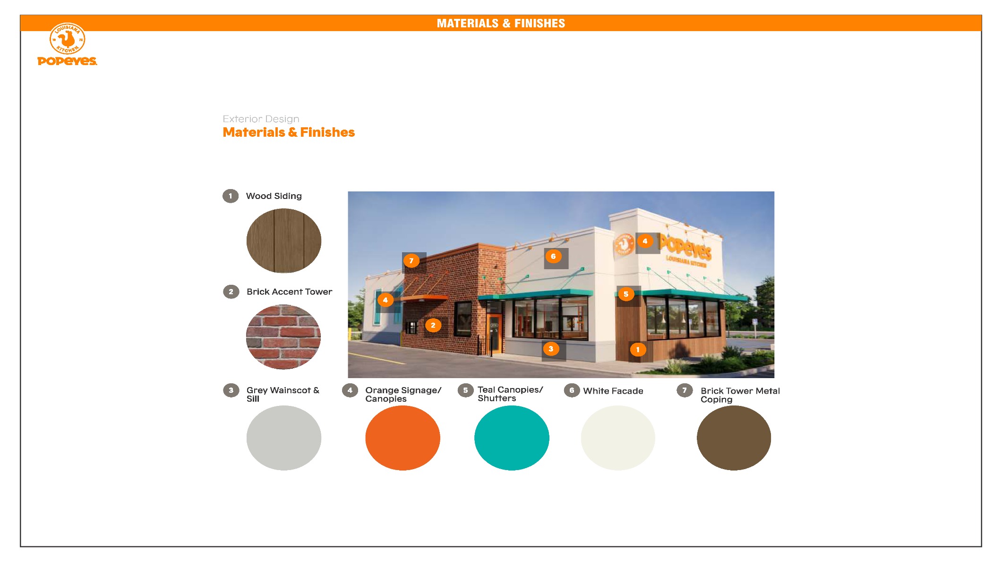
Architecture

Slide 12
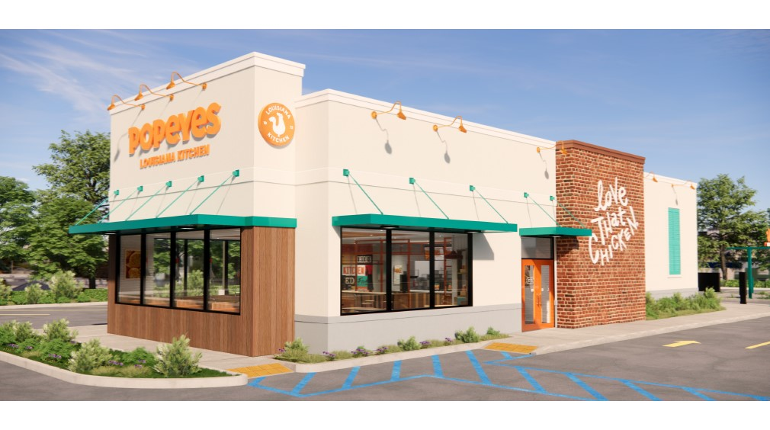
Architecture

Slide 13
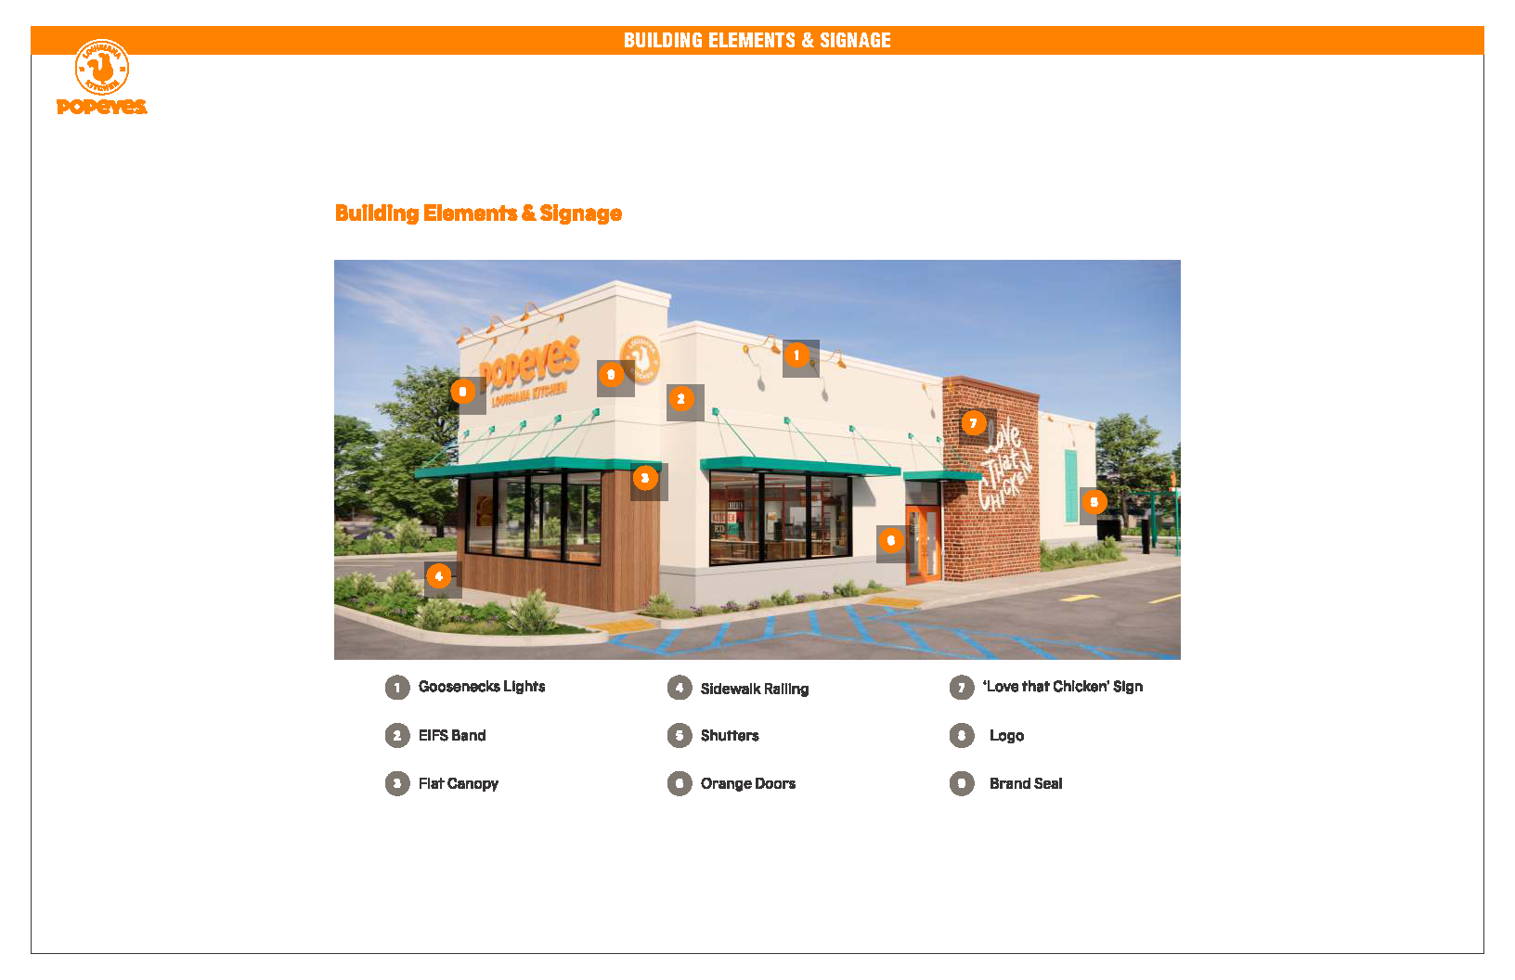
Architecture

Slide 14
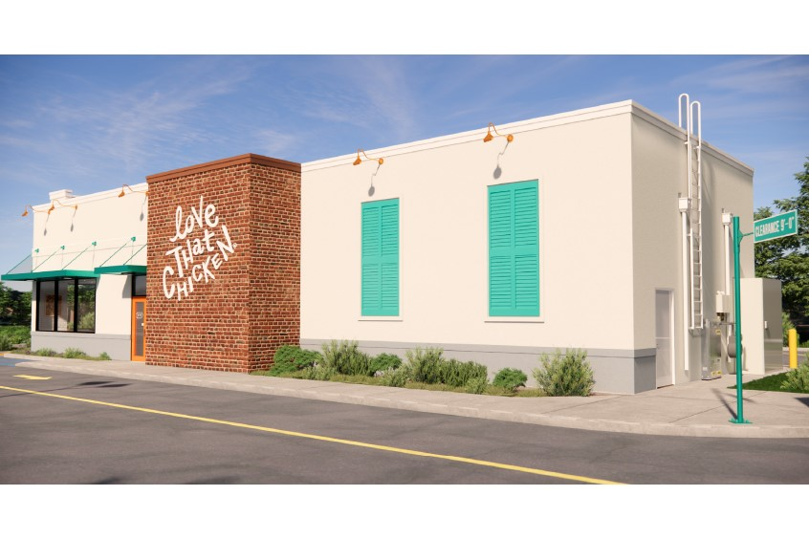
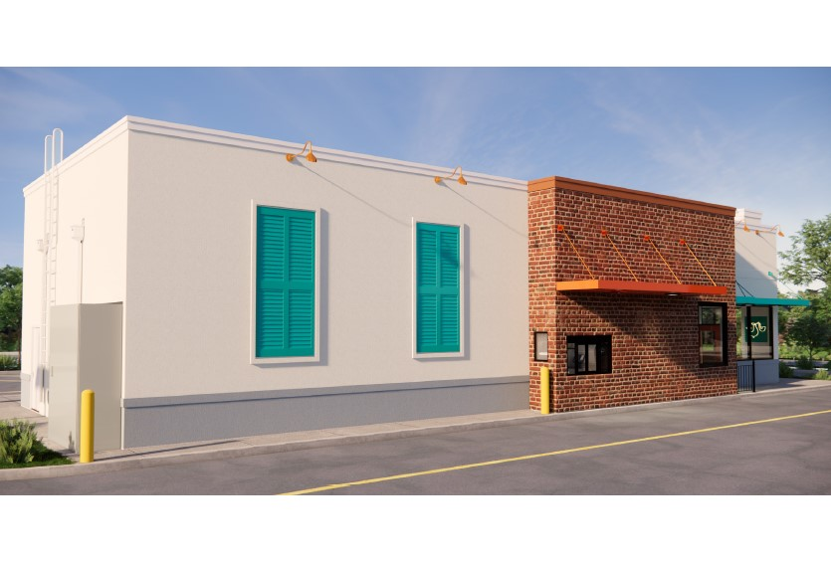
Architecture

Slide 15
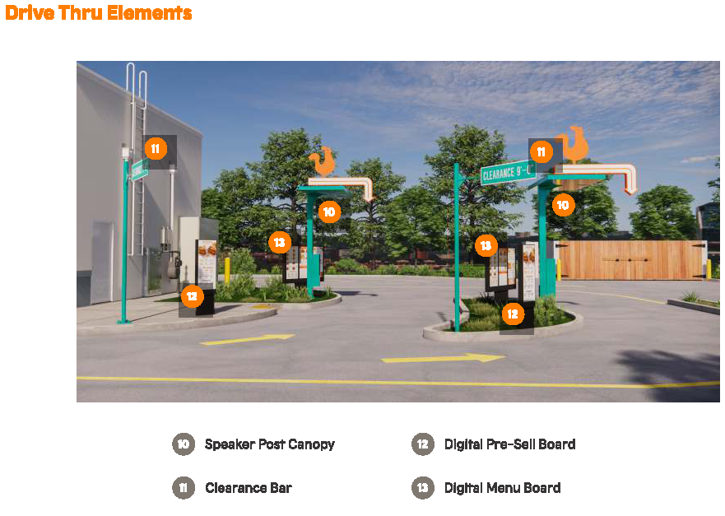
Architecture – Drive Thru Elements

Slide 16
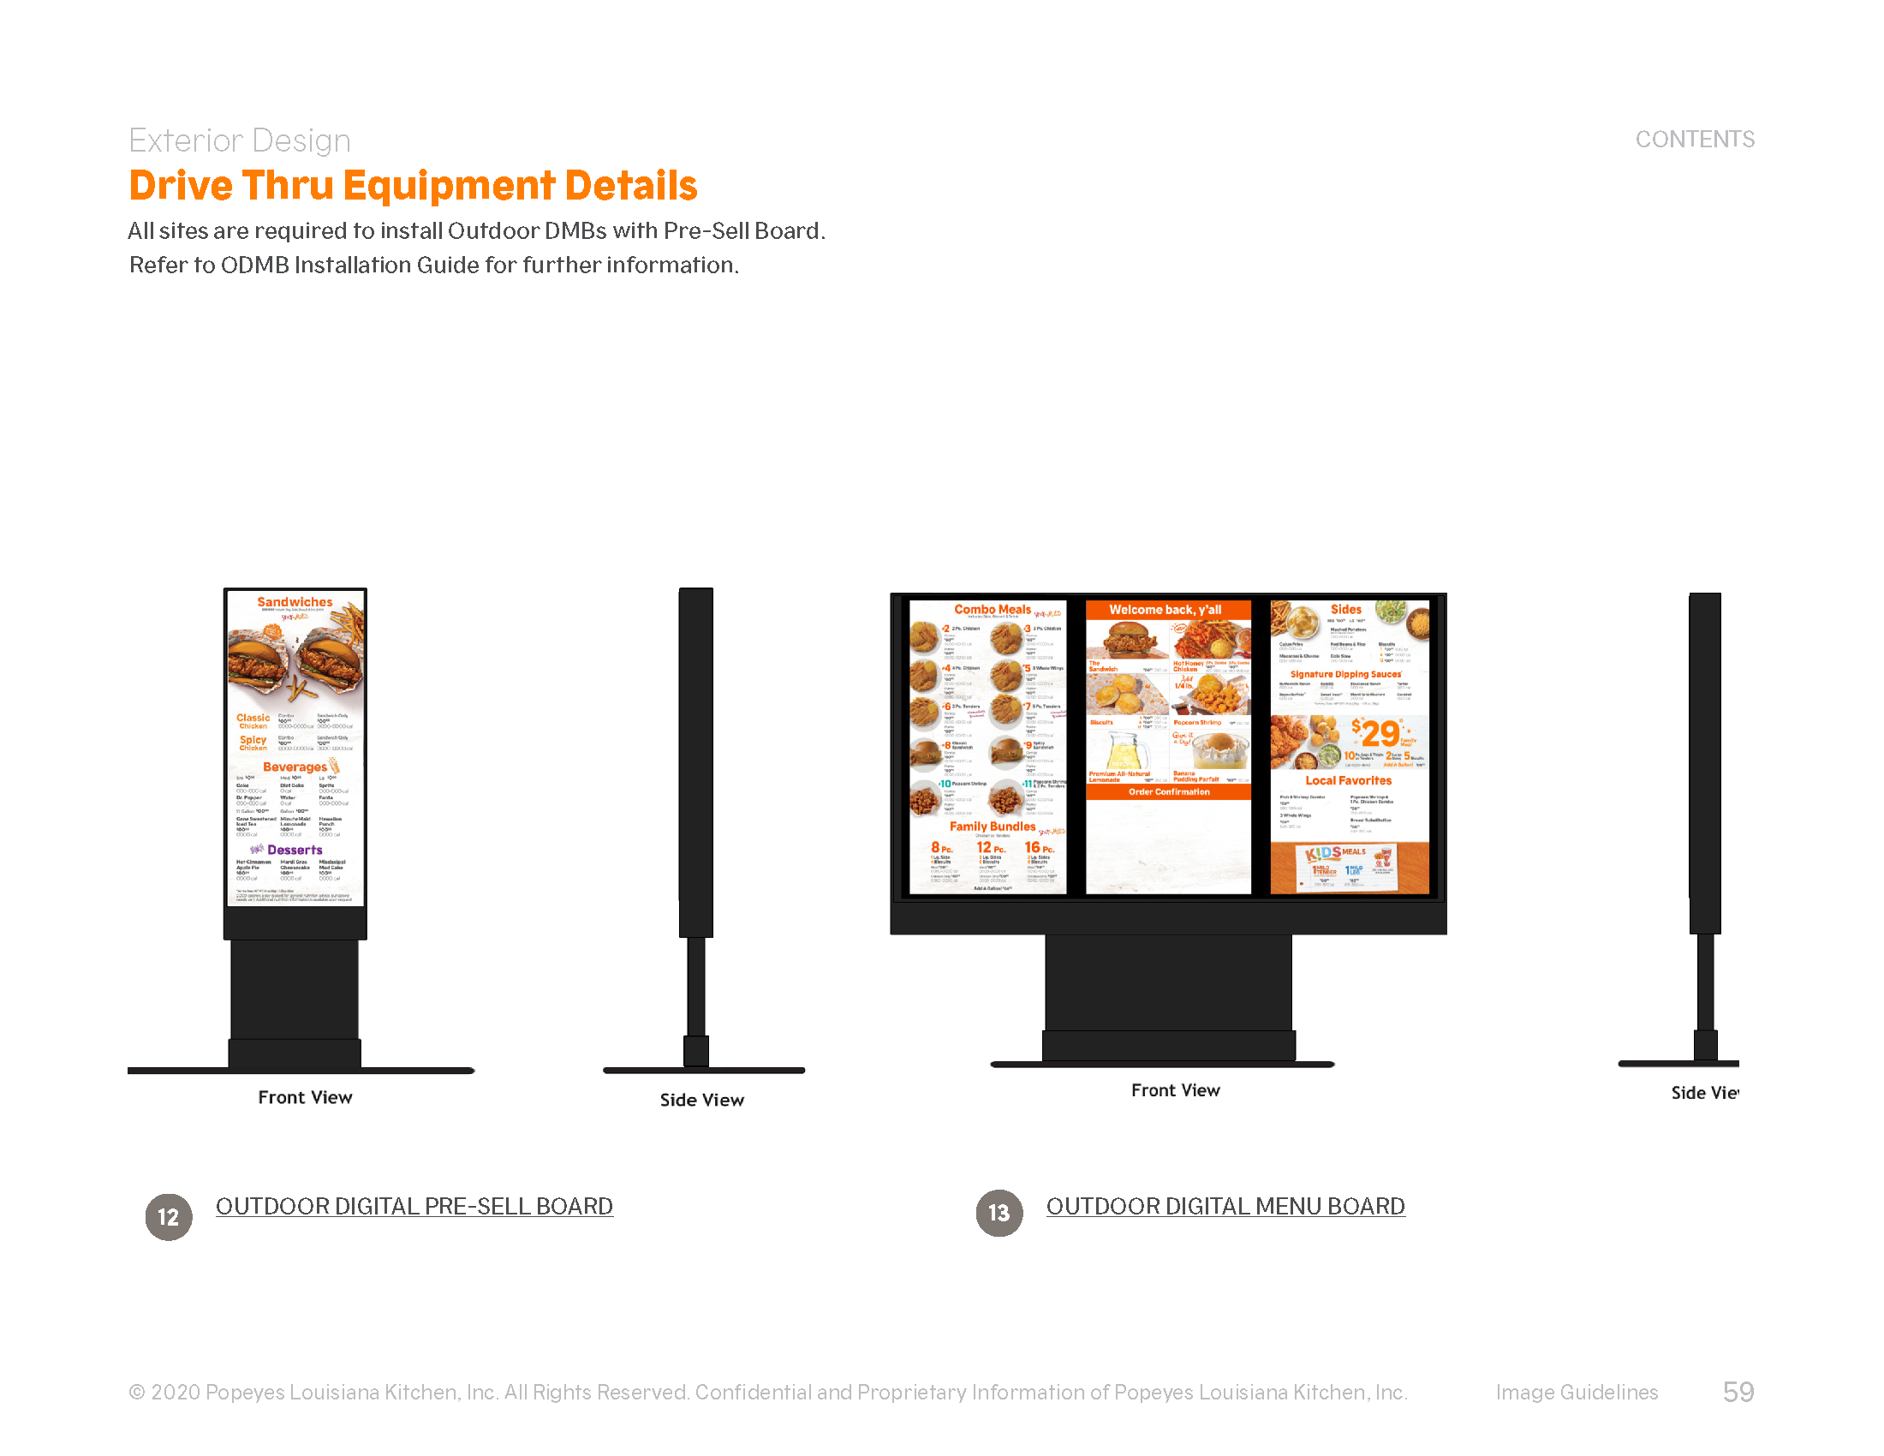
Architecture – Drive Thru Elements - Menu Boards

Slide 17
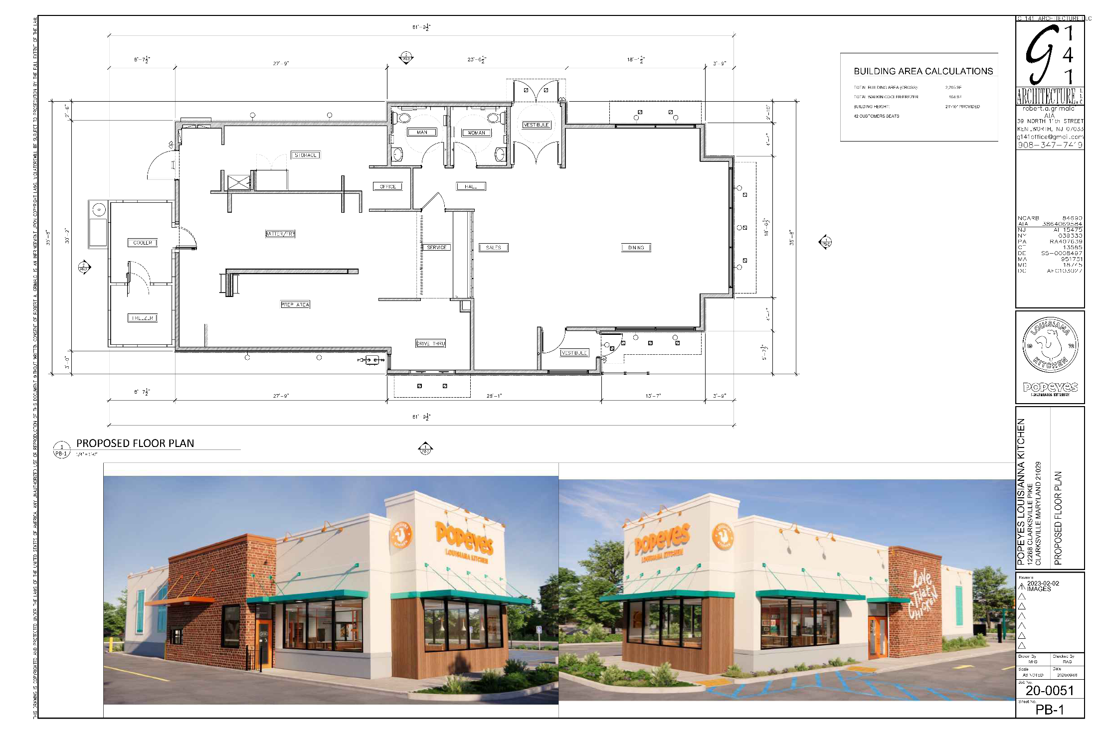
Architecture

Slide 18
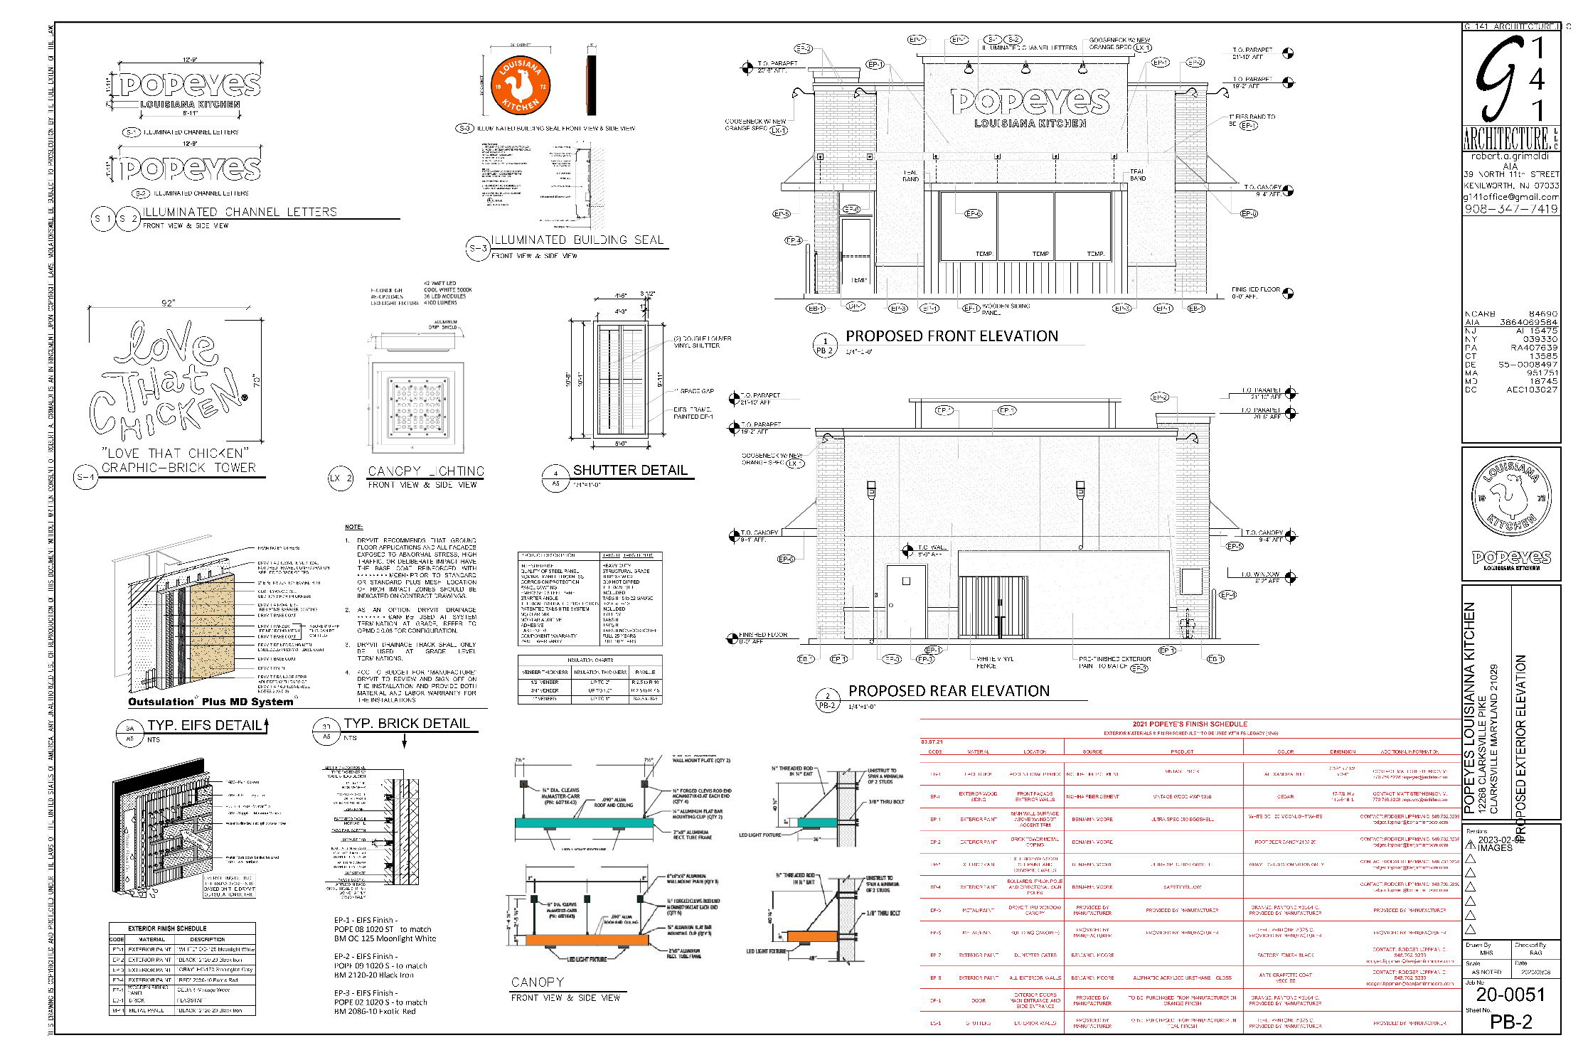
Details

Slide 19
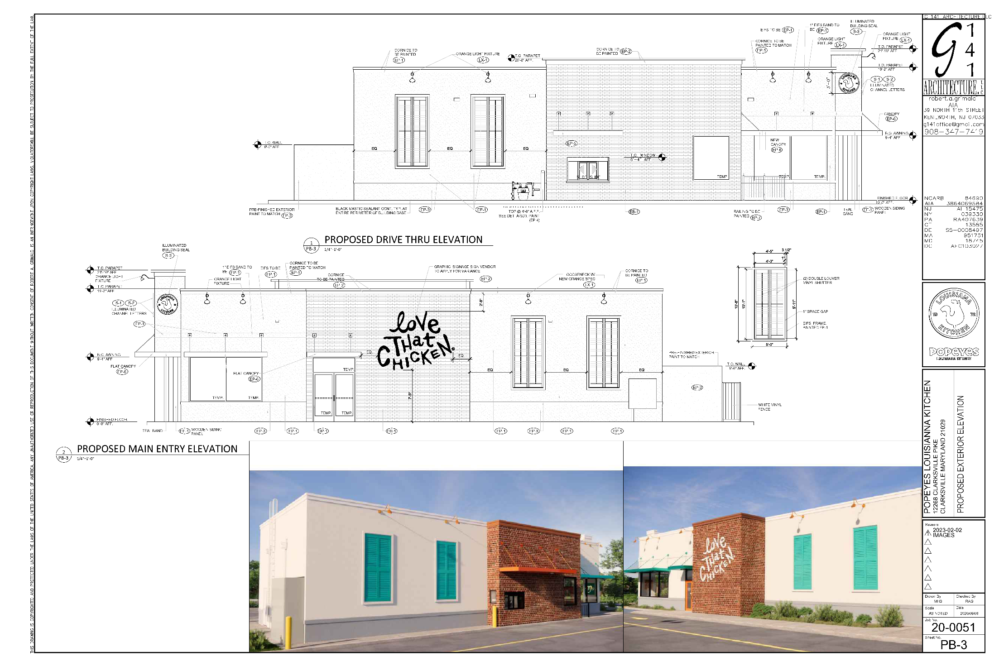
Elevations

Slide 20
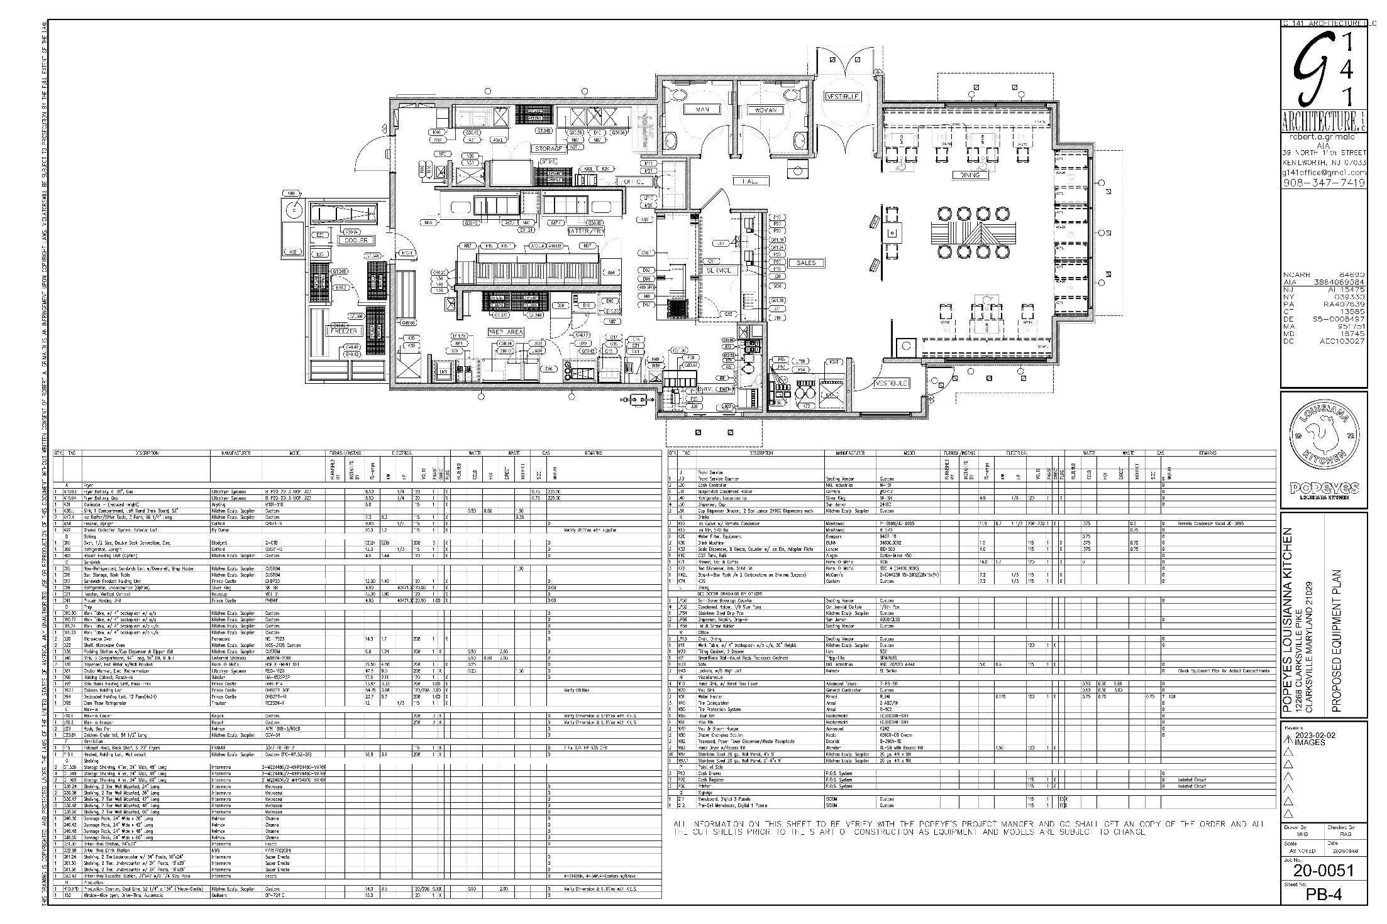
Floor Plan

Slide 21
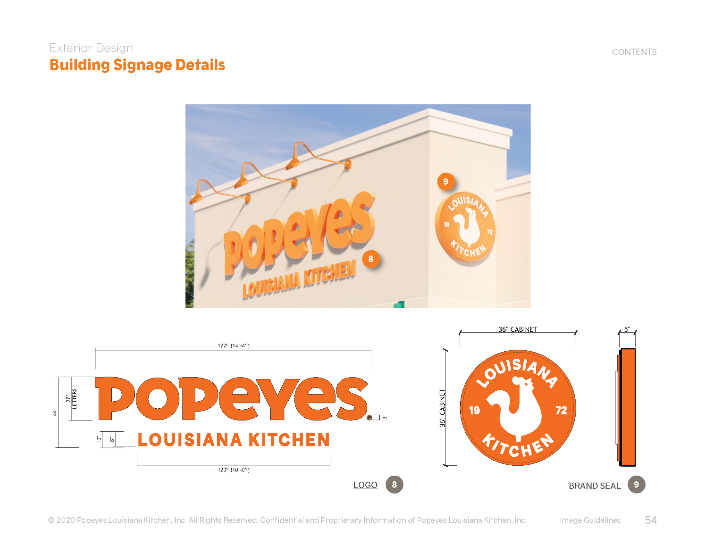
Signage

Slide 22
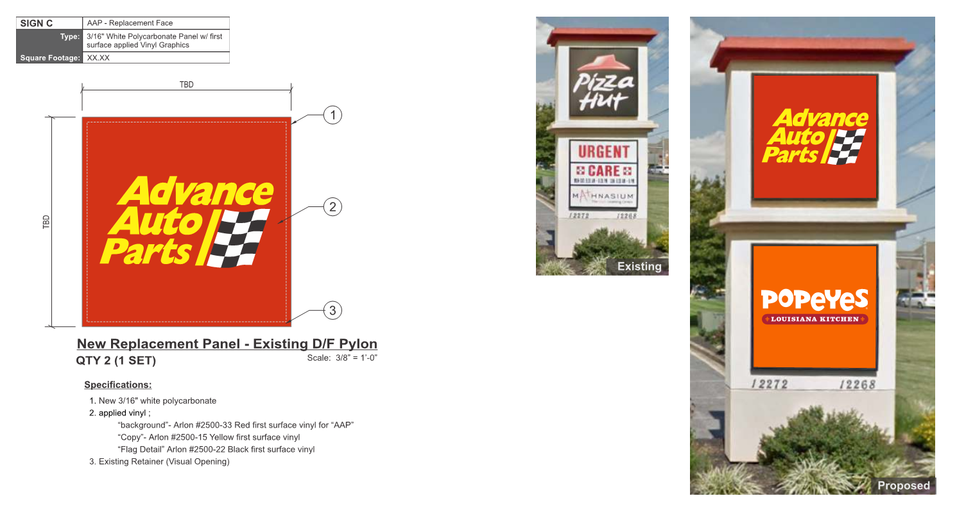
Signage

